Slide 1

Addressing Water Inequality: An Analysis of California's Public Water Systems and Policy Solutions for Disadvantaged Communities
Neha Burri – 11694929
Akhila Reddy Kommiti – 11705751
Pooja Thella – 11713291
Marisa Simha Sai Ravi Kumar - 11684252,

Slide 2

Contents
Introduction
Problem Statement
EDA Research Questions
Predictive Modelling Research Questions
Literature Survey
Exploratory Data Analysis
Modelling
Results
Conclusion
Future Work

Slide 3

Introduction
Drinking water safety constitutes an essential human right.
Several California regions face water inequality problems mainly affecting disadvantaged community populations.
Water inequality exists in California due to three main factors: social elements, economic factors, environmental elements, outdated infrastructure, and racial discrimination.
Lack of access to clean water can cause serious health problems, economic hardships and deepens poverty and social inequality.

Slide 4
Problem Statement
There has been uneven distribution of safe drinking water across California due to disadvantaged water systems.
Some areas in California have worse water systems, making it harder for people there to get safe drinking water.
Old water systems and polices may not work now because of population growth and urbanization.
Ground Water systems are at risk of contamination and environmental damage.
Our research mainly focuses on these problems and predict where the systems can fail and suggests solutions to make water distribution fair and reliable.

Slide 5
EDA Research Questions
1. Our aim is to discover dense regions or water system-deprived areas for better distribution of resources and regulatory attention.
2. The goal is to show differences in water system capacity alongside documentation of communities without adequate water services.
3. We intend to analyze population dependence on unique water sources in addition to identifying drought and contamination exposure risks.
4. Assessing operational readiness levels and detect which systems would face potential operational difficulties due to lack of operator skills

Slide 6
Predictive Modelling Research Questions
To preventively detect systems which might fail or deactivate so that appropriate protective actions can be executed.
Predict which California water systems will exceed their current capacity due to future population growth and identify where modernization of infrastructure is required.
Predicting which water systems will qualify as Disadvantaged Small Community Water Systems (DAVCS) by analyzing population and fee classification with socioeconomic indicators?
4. Predicting delays in sanitary inspections across different population groups and water source types to improve the scheduling of high-risk system monitoring?

Slide 7
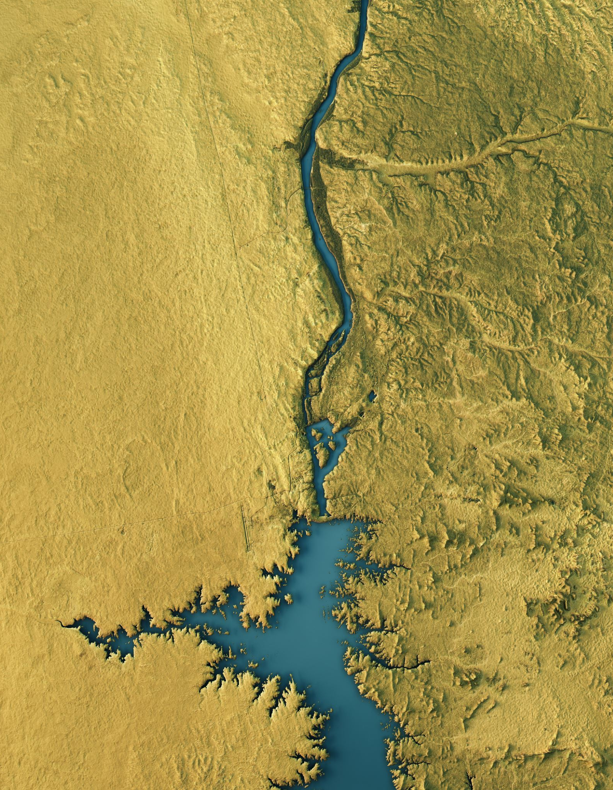
Literature Survey
According to Agusc Pérez-Foguet (2023), climate change has made dry periods longer and more frequent, putting significant stress on California’s aging water infrastructure
He also highlighted that over-extraction of groundwater has caused land subsidence and worsened water quality in rural areas.
Chen and Franklin (2023) demonstrated that rural regions in California face higher rates of surface water pollution, particularly from agricultural runoff.
Their study predicted that future climate variability could worsen contamination levels in these vulnerable regions.

Slide 8
Literature Survey
According to Acquah and Allaire (2023), Latino and African American communities are disproportionately affected by poor water quality due to systemic environmental racism.
They also found that political and financial barriers prevent these communities from securing necessary infrastructure improvements.
Fernandez-Bou et al. (2023) emphasized that repurposing agricultural lands could enhance water access and environmental justice.
Their work suggested that aligning land-use changes with equity goals would maximize socio-environmental benefits.

Slide 9
Literature Survey
According to Goddard et al. (2021), California’s historic water policies favored urban and agricultural elites, neglecting rural and disadvantaged populations.
They argued that equitable water management requires revising state priorities and increasing support for underserved areas.
According to London et al. (2021), disadvantaged unincorporated communities suffer from systemic exclusion in water governance.
Their study recommended building participatory models to ensure fairer infrastructure planning.

Slide 10
Literature Survey
Archer et al. (2024) found that predictive analytics can forecast water contamination risks like arsenic exposure, improving early response efforts.
They emphasized that integrating real-time monitoring can significantly enhance resilience against drought emergencies.
According to Siirila-Woodburn et al. (2021), reduced snowpack will severely impact California’s water storage and supply systems.
They highlighted the urgent need for new conservation technologies to adapt to these future shortages.

Slide 11
Methodology
Dataset Overview
Dataset Name: Drinking Water Public Water System Information – California
Source: U.S. Environmental Protection Agency (EPA) via Data.gov
Size: 7,815 rows × 35 columns

Slide 12
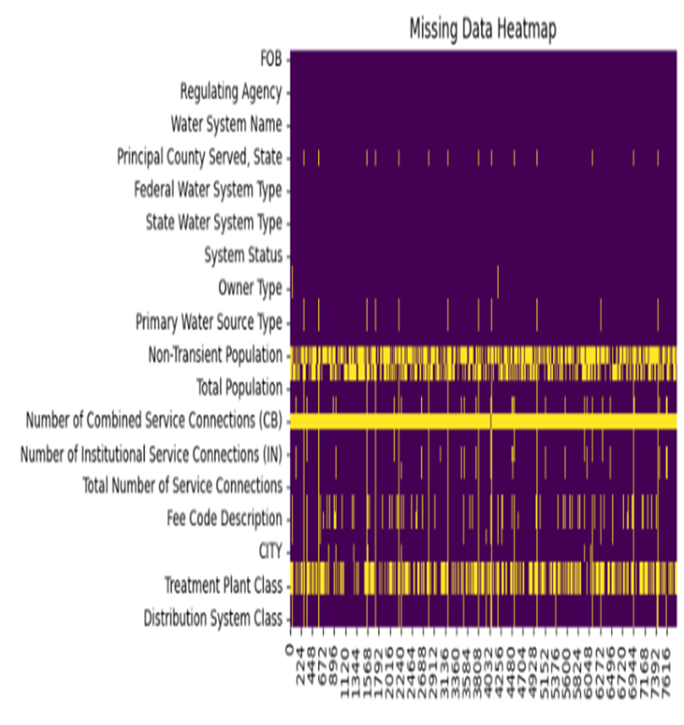
Exploratory Data Analysis
Handling Missing Data
There is a substantial amount of missing data for the Non-Transient Population and the Transient Population among water systems in the dataset.
The Principal County Served state column has 208 unrecorded entries, while Residential Population has a deficit of 4,051 values.
Removed all the null values from our dataset

Slide 13
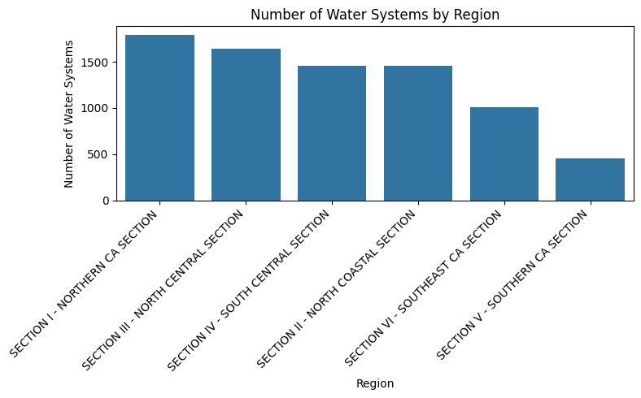
Exploratory Data Analysis
The graph shows about the Number of Water Systems by Region
Northern California Section has the highest number of water systems.
Southern California Section has the fewest water systems compared to other regions.
Water systems are more concentrated in Northern and Central California regions.

Slide 14
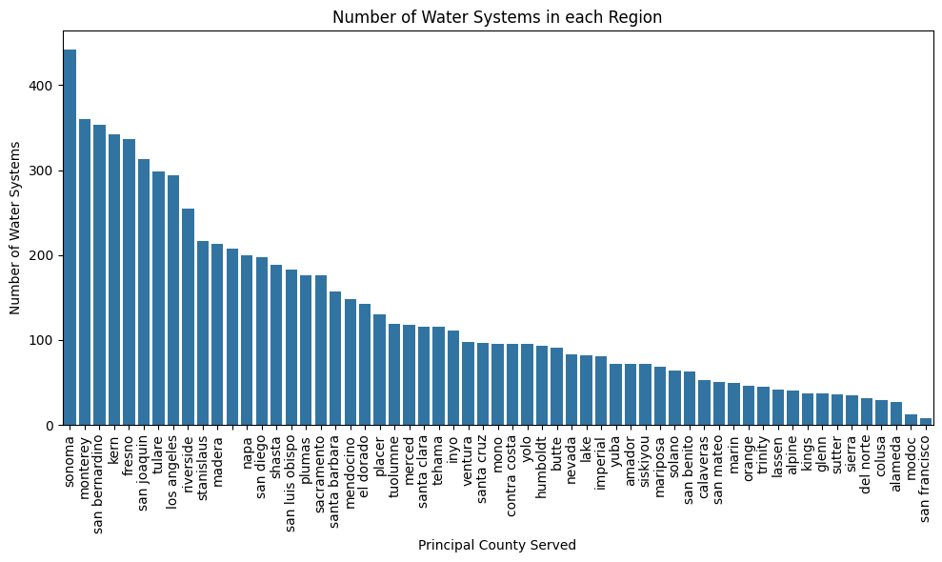
Exploratory Data Analysis
The following graph gives us an overview about water systems in various counties in California.
Sonoma County has the highest number of water systems in California.
San Francisco has lower number of water systems
Rural counties have more individual water systems due to decentralized water infrastructure.

Slide 15
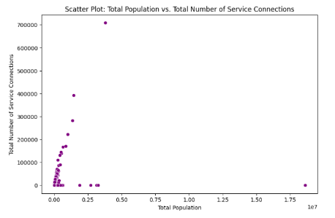
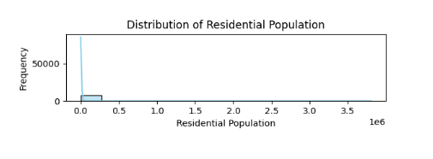
Exploratory Data Analysis
From both the graphs we can see that Distribution of Residential Population is highly skewed. Most water systems serve small residential populations, while few systems serve very large populations.
Systems with higher populations generally have more service connections, but there are some outliers
Rural systems show many small-sized systems, which may face funding and maintenance challenges..

Slide 16
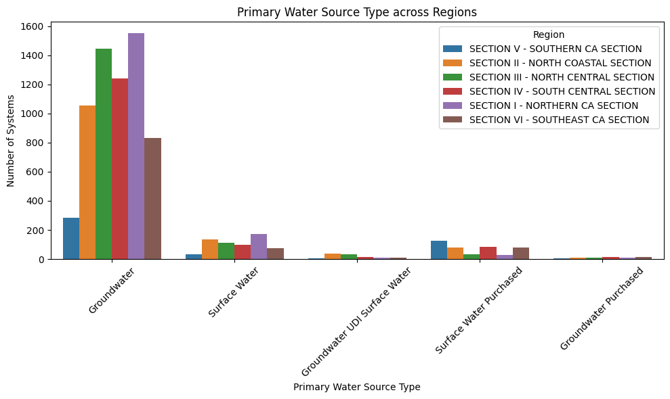
Exploratory Data Analysis
The visualization shows the Primary Water Source Type Across Regions
We can analyze Groundwater is the dominant water source across all regions.
Northern California Section (Section I) has the highest number of groundwater-dependent system
The California’s public water systems heavily rely on local groundwater resources.

Slide 17
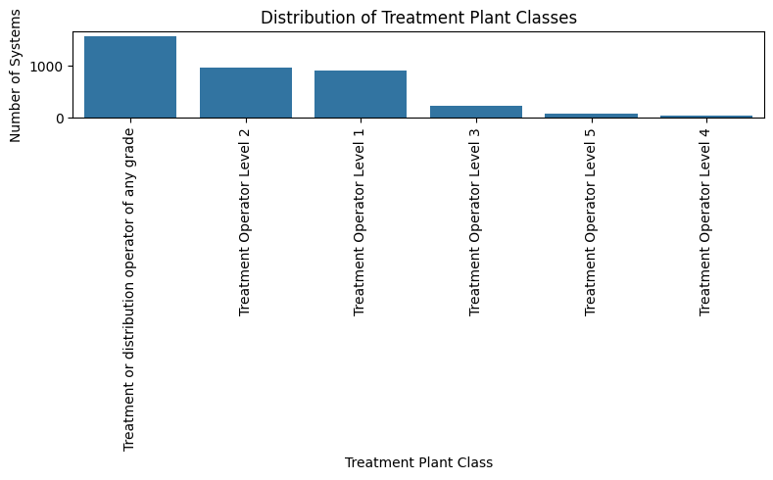
Exploratory Data Analysis
The following graphs shows the Distribution of Treatment Plant Classes
Most systems fall under "Treatment or Distribution Operator of Any Grade" , which indicated basic or flexible certification requirements.
Most systems operate with lower-level or generalized operator certifications. This can lead to potential challenges in handling complex water treatment processes.

Slide 18
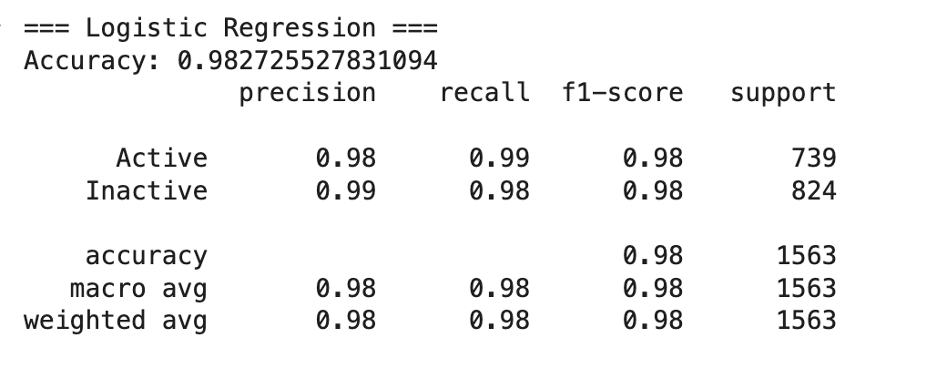
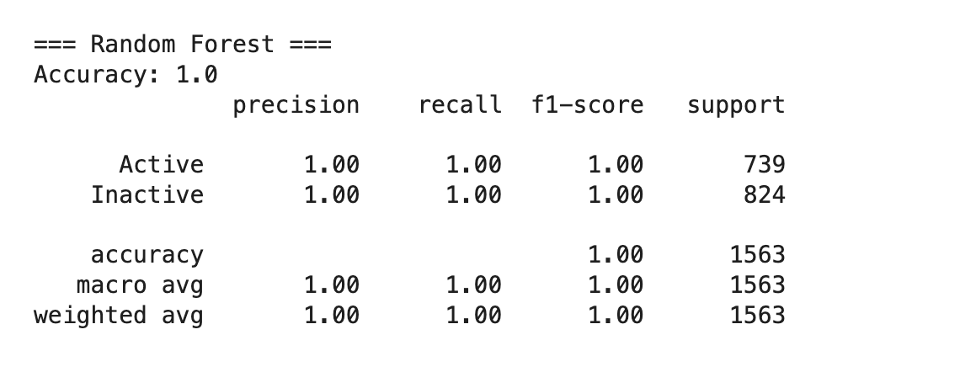
Modelling & Results
System Status Prediction
Our goal is to predict which systems are likely to fail and take necessary steps.
We used Logistic Regression, Random Forest and Gradient Boosting
Random Forest Performed Well

Slide 19
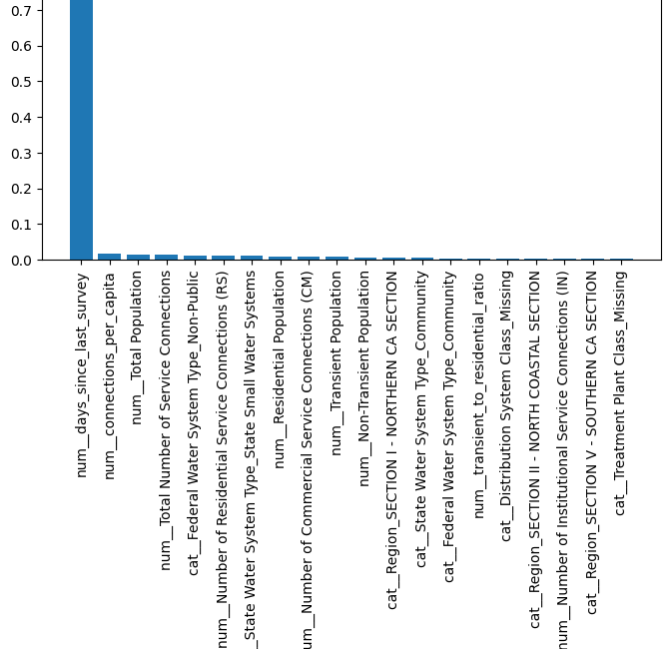
Modelling & Results
The following visualization shows the top 20 most important features for System Status Prediction in Random Forest
Across all models, the most predictive features were:
Total Population Served
Total Number of Service Connections
Primary Water Source Type
Owner Type and Region

Slide 20
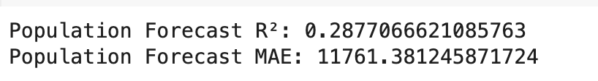
Modelling & Results
Population Growth Impact on Water Systems
This task helps forecast future service demand and identify regions where growth may exceed system capacity.
We used Gradient Boosting Regressor for this prediction.

Slide 21
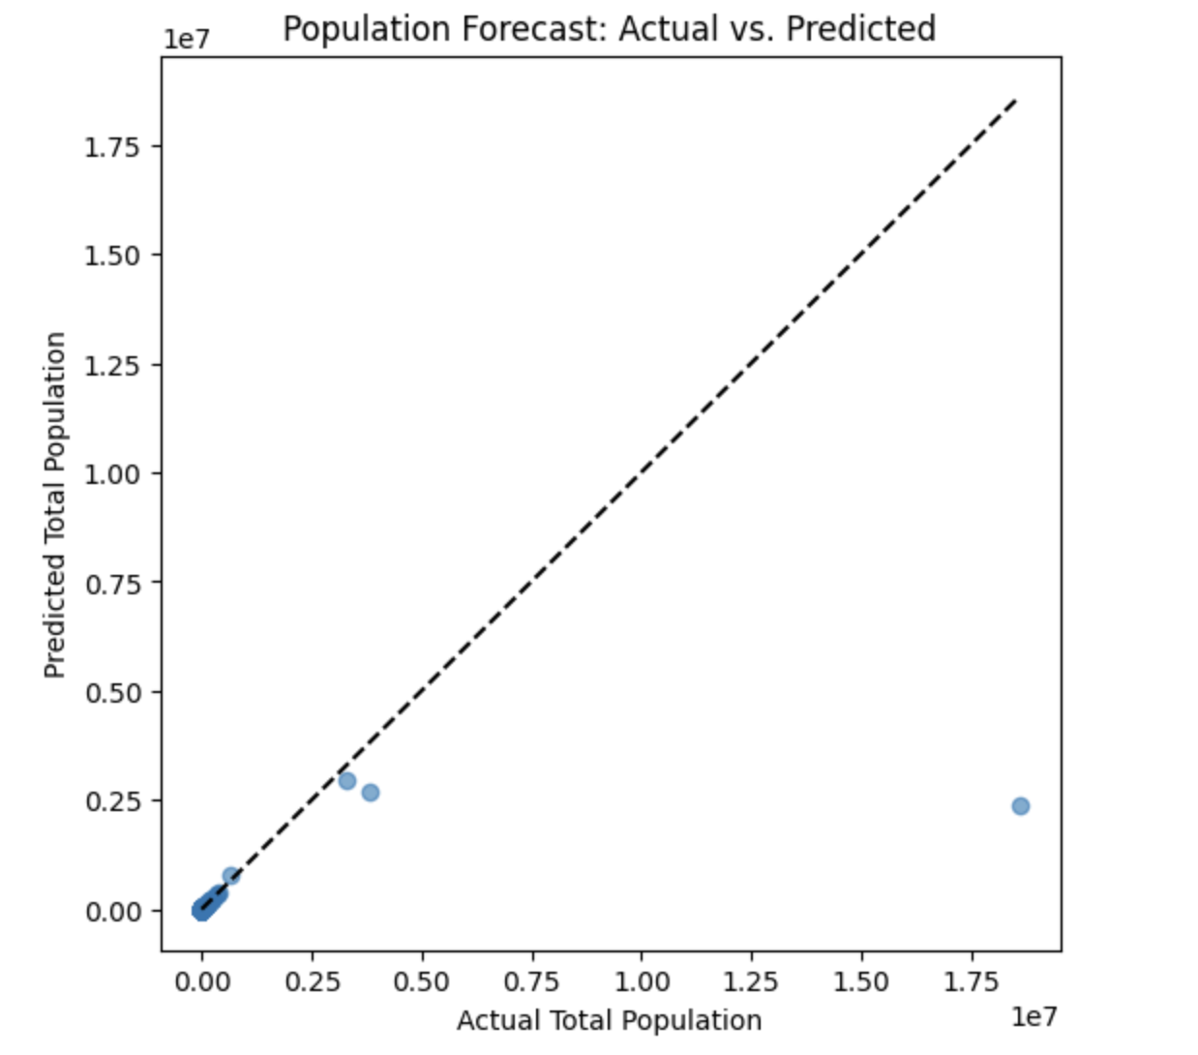
Modelling & Results
Population can be reliably estimated from system characteristics using machine learning. This enables targeted planning in rapidly growing or under-resourced areas.
We can use this forecasting model to proactively prioritize capacity upgrades, especially in counties with accelerating population trends and limited infrastructure expansion.

Slide 22
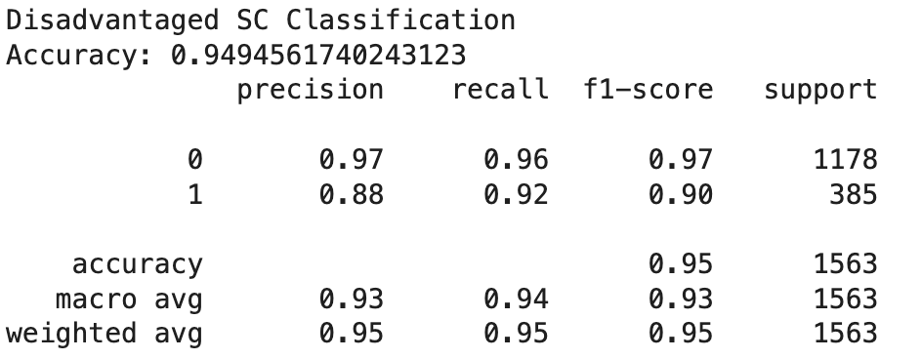
Modelling & Results
Disadvantaged Community Identification
We developed a Random Forest classification model to forecast whether a water system qualifies as a Disadvantaged Small Community.
We derived Target variable from the "Fee Code Description" field by identifying the presence of "Small Community" labels.
We trained model using balanced class strategy to handle label imbalance

Slide 23
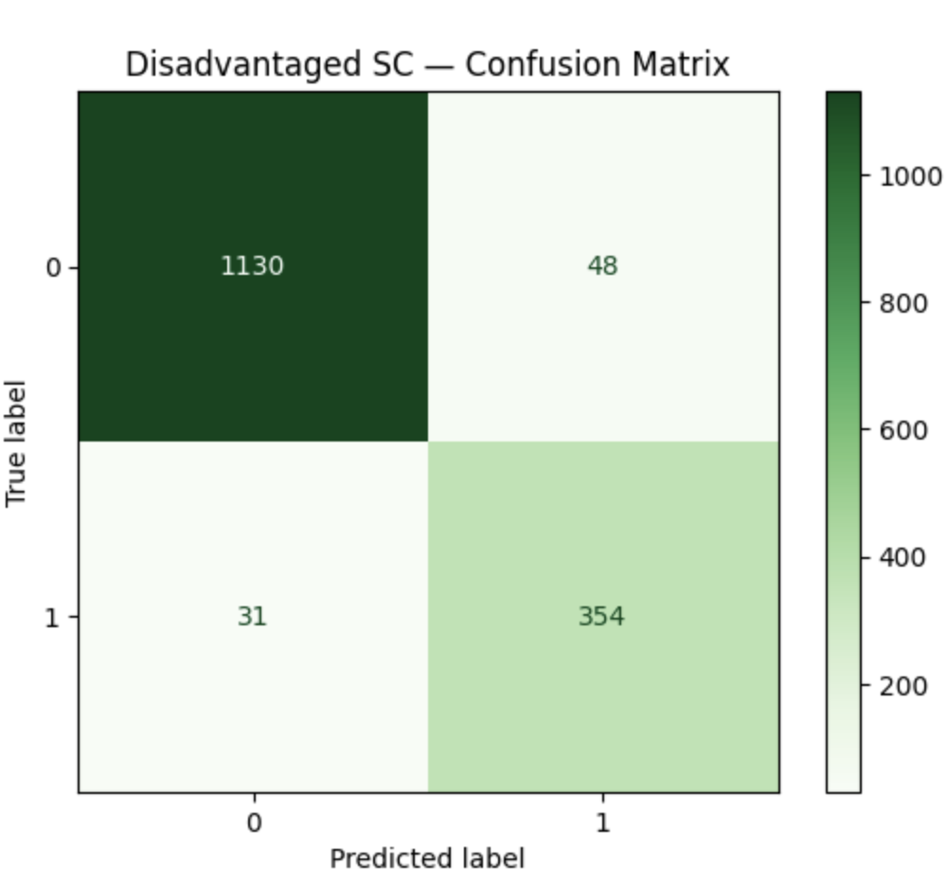
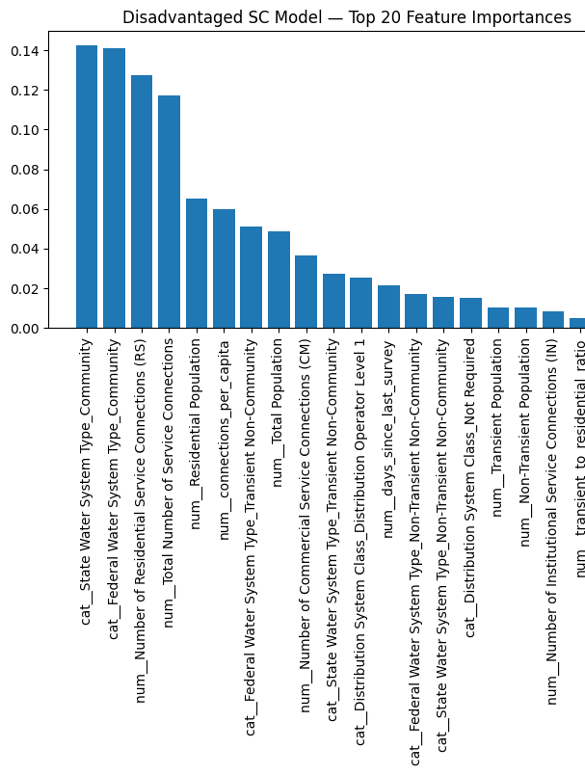
Modelling & Results
The model effectively identifies systems at risk of being overlooked for state and federal funding due to low visibility.
By Deploying this we can support equity-based funding decisions, ensuring small and disadvantaged communities receive timely infrastructure assistance.

Slide 24

Modelling & Results
Sanitary Survey Frequency Prediction
We developed a Poisson regression model to predict the number of days since the last sanitary survey.
This prediction supports risk-based scheduling and helps identify systems likely overdue or approaching inspection thresholds.
The model enables quantitative estimation of survey recency and helps prioritize high-risk systems.

Slide 25
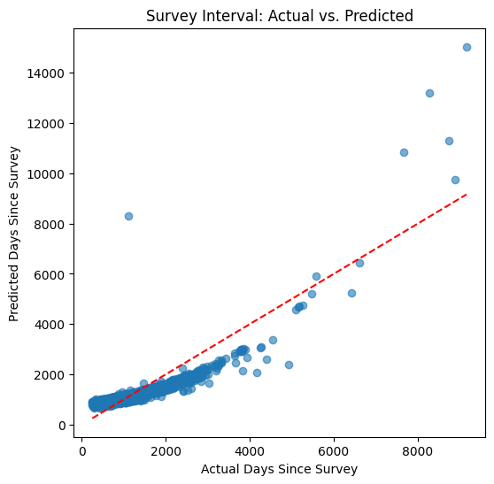
Modelling & Results
The scatter plot compares the actual number of days since the last sanitary survey with the model’s predicted values.
The red dashed line represents perfect prediction (i.e., predicted = actual).
Most points are clustered near the diagonal, indicating strong model alignment for the majority of systems.
A few systems with very high actual values (outliers) show underprediction, which indicate data irregularities or unique cases.
The pattern shows that the model performs consistently for small-to-medium intervals, making it effective for routine inspection forecasting.

Slide 26
Conclusion
Many people in California still don't get safe water.
Poor and minority communities suffer more.
We should use technology and better policies to fix this.
The goal is fair and safe water for all.

Slide 27
Limitations & Future Work
Limitations
Missing or outdated data: Some records (e.g., last survey date or population fields) were missing or inconsistently reported.
Static population assumption: Population growth projections used a constant growth rate, which may not reflect localized demographic changes.
Fee code simplification: Classification of disadvantaged communities relied on keyword search in fee codes, which may not capture nuanced socioeconomic factors.
Model generalization risk: Models are trained on current data and may not generalize well to future regulatory or environmental shifts (e.g., new inspection policies, droughts).
Future Work
Integrate external data sources: Include census data, income levels, and regional drought patterns to better assess risk and disadvantage.
Time series forecasting: Extend models to forecast future risk levels over time (e.g., when a system will become overdue).
Interactive dashboard: Deploy model predictions into a live dashboard for agencies to monitor system risk levels and inspection schedules.

Slide 28

THANK YOU

